Slide 1
MAJOR - PROJECT ON
WEATHER FORECAST USING IOT & ML

Slide 2
MEET OUR TEAM
Group-22
Project Mentor
Mr. Jitesh Kumar Bhatia
Ass. Professor GLA
Bharat Sharma (191599003)
Role : Team Lead, Model Building, Model Deployment, Project Documentation
Mohit Sharma (191599011)
Role : Hardware coding
Abhishek Tomar (181500030)
Role : Hardware Integration
Pushpraj Singh (191599015)
Role : Data Pre-processing, Model Testing

Slide 3

INTRODUCTION
Weather forecasting is the application of science and technology to predict the state of the atmosphere for a particular location.
This system will predict weather parameters through hardware such as temperature, humidity, wind speed, wind direction and rainfall value.

Slide 4
Project phases
Project Design
Sensors integration with software
Data Collection
Deployment
Model deployment
Model performance/accuracy analysis
Dashboard for results
01
02
03
04
05
Project requirement analysis
Understand problems statements
Hardware and software
Database
Development
Data Pre-processing
Model Building
Testing
Model testing by using other
ML techniques.
Gantt chart

Slide 5
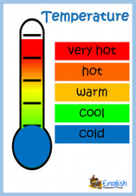
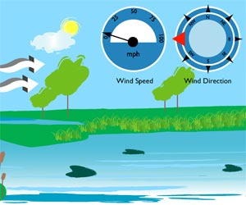



PROJECT PROBLEM STATEMENTS
Collect Data from the sensor.
Data Pre-processing
Model Building
Deployment
Testing
Wind Speed & Direction
Rainfall

Slide 6
Weather Parameter to be measured and predict
Weather Temperature
Weather Humidity
Wind Speed
Wind Direction
Weather rainfall
Weather Atmospheric Pressure
Process
We collect all the values from the sensor and send to the google sheet through nodemcu.
We used this data in R for data pre-processing and prediction model building by using some historical data sample.

Slide 7
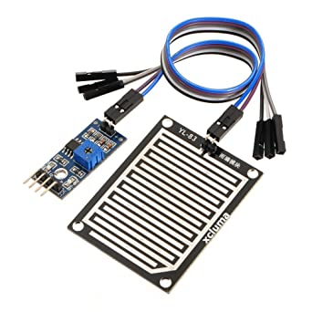
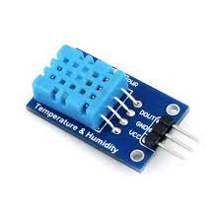


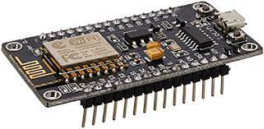
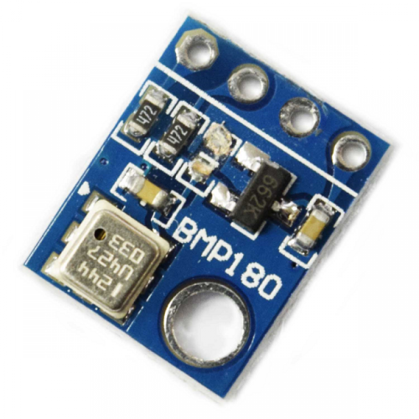
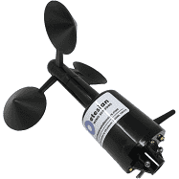
Hardware & Software Communication
4 sensors send data to nodemcu
Store Data on GoogleSheet
Data Pre-processing
Model Building
Model Testing
Model Deployment

Slide 8
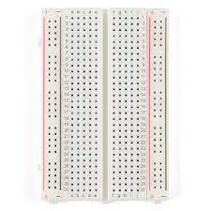
Hardware required
NodeMCU Micro-Controller
Wind Speed & direction sensor
Rainfall sensor
DHT11
Barometer Sensor
Bread Board

Slide 9
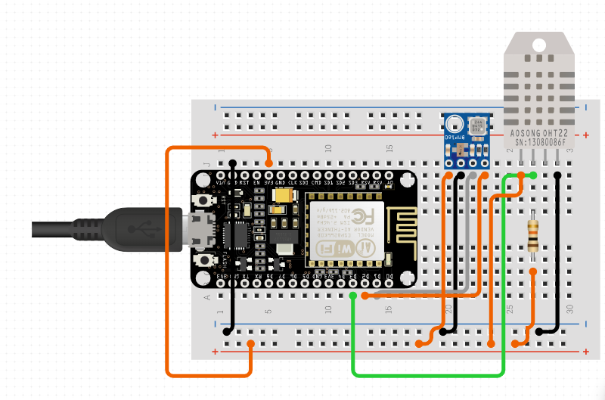
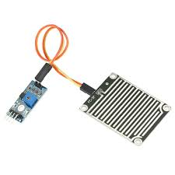
Pin Diagram
Nodemcu D2 - DHT11
Nodemcu A0 - rainfall
Nodemcu D1 - barometer SCL
Nodemcu D2 - barometer SDA

Slide 10
Arduino code
R Code
Google Sheet Code
Project Code

Slide 11
Pricing table
Hardware Components
S.N | Name of Components | Unit price | Total | Vendor Name | Link of Vendor | Life Span | Power(kwh)/month
1 | NodeMCU | 218.00 | 218.00(1x) | electronicscomp | click here | -- | --
1 | Wind Dir. & Speed Sensor | 4799.00 | 4799.00(1x) | Robo.in | click here | -- | --
2 | DHT11 | 125.00 | 125.00(1x) | electronicscomp | click here | -- | --
3 | Barometer | 54.00 | 54.00(1x) | electronicscomp | click here | -- | --
4 | Rainfall Sensor | 99.00 | 99.00(1x) | Robo.in | click here | -- | --
5 | breadboard | 65.00 | 65.00(1x) | electronicscomp | click here | -- | --
6 | Jumper wire | 49.00 | 147.00(1x) | electronicscomp | click here | -- | –-
Estimated Cost(Rs) | 5408.00 | 5507.00
0.00u

Slide 12
Software
Language
R Studio
Arduino
Google Sheet
GitHub
Embedded C
R

Slide 13
Overall pricing
Project Cost Estimate
S.N | Components | Monthly | Yearly | Remark
1 | Hardware | -- | 5507.00 | These hardware can run several years
2 | Software/ cloud | 0.00 | 0.00 | We use open source platforms
3 | internet | 200.00 | 2400.00 | May be vary with time
4 | Electricity | -- | -- | --
5 | Installation | -- | -- | --
6 | Maintenance | -- | -- | --
7 | Deployment | -- | -- | --
Total | 7907.00
Some cost of the project module not added

Slide 14
Project Gantt chart
Phase | Activities | Status | Remark
1 | Project requirement analysis | Done | 10% of project done
2 | Project Design & Prototyping | Done | 20% of project done
3 | Project Development and Code | running | 60% of project
4 | Project Deployment | Pending | 80% of project
5 | Project Testing | Pending | 100% of project

Slide 15
Application Areas.
Agriculture
Sports
Tourism
Air Traffic
Marine and Forestry
Manufacturing Industries at Cloudy side

Slide 16
THANK YOU !
For Your Attention

